Slide 1
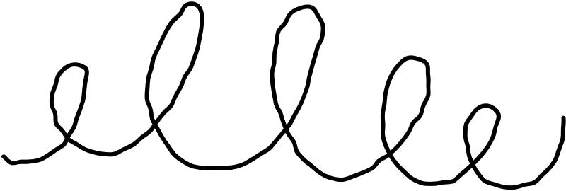












DVRT ASG Insights
Assignment
Presentation
Tiffany Loy (S10266970K)
DVRT
Notes:
Good morning! Today, we will be presenting our comprehensive dashboard storytelling presentation, which we have meticulously crafted to address the needs of various stakeholders within the company.

Slide 2







Today's Agenda
1
Problem Statement
2
Key Metrics
3
Key Findings
4
Recommendations
Notes:
this will be the agenda for today. first, we will start off with the introduction, followed by the individual stakeholder storytelling. finally, we will end of with the conclusion.

Slide 3




Problem Statement
1
Notes:
for the first visual, i chose the graph that shows the trend of the profit for every month. the reason why i choice this

Slide 4



Problem Statement
sales, inventory, and product data exists in separate datasets
Store managers and operations lack visibility into whether stock matches customer demand
results in:
- overstocked slow-moving products
- stock shortages
- manual, slow decision-making
business impact:
- lost sales opportunities
- reduced customer satisfaction & retention

Slide 5


Solution
integrated brands, categories, orders, order_items, products, stocks & stores csv
unified, store-level view of:
- what is selling
- what is in stock
- where mismatches exist
near real-time visibility
designed for operational decision-making
Notes:
Assuming that the current warehouse is located in southeast Australia – which is where most warehouse is located in Australia, the inventory manager can compare that to the number of customers from the different states in Australia. This is important as it can affect the duration of delivery, which may affect the customers liking and satisfaction with the company. Currently, the orders can be delivered to customers in New South Wales, Victoria, Australian Capital Territory and Tasmania relatively quickly. However, the customers in the other parts of the country might not be able to receive their orders in that same duration. This may result in customers not wanting to order from the store again. Hence the inventory has to take this into account and think about setting up another inventory warehouse in Central Australia. This way, there are orders being delivered out from different parts of the country to reach customers faster. The inventory manager can think about splitting up the stocks among both warehouses and if one warehouse ever run low on stocks for specific items, it is possible for them to get some stocks from the other warehouse if the other warehouse has an excess in stocks.

Slide 6
Key Metrics
2
Notes:
for the first visual, i chose the graph that shows the trend of the profit for every month. the reason why i choice this

Slide 7


Total Quantity Sold
Current Stock
shows customer demand for each model respective to stores
shows inventory available for each model respective to stores
Stock Gap
Stock Status
stock - demand, show amount of stock that the store should have
stock status: out of stock, low stock, balanced, overstocked

Slide 8
Key Findings
3
Notes:
for the first visual, i chose the graph that shows the trend of the profit for every month. the reason why i choice this

Slide 9






KEY FINDING 1
Many products are overstocked
Several overstocked items sold only 1-2 but have 20 plus in stock
Indicates:
- weak demand
- excess inventory tied up unnecessarily
Business Implication:
- storage cost
- capital inefficiency
- poor inventory turnover
Not all stocks needs to be replenished because it exists
Notes:
A sales manager is responsible for overseeing the sales team, developing strategies to drive sales growth, managing customer relationships, and ensuring that the targets set are met. A sales manager also analyses data, forecasts future sales, and provides insights to improve sales performance.

Slide 10
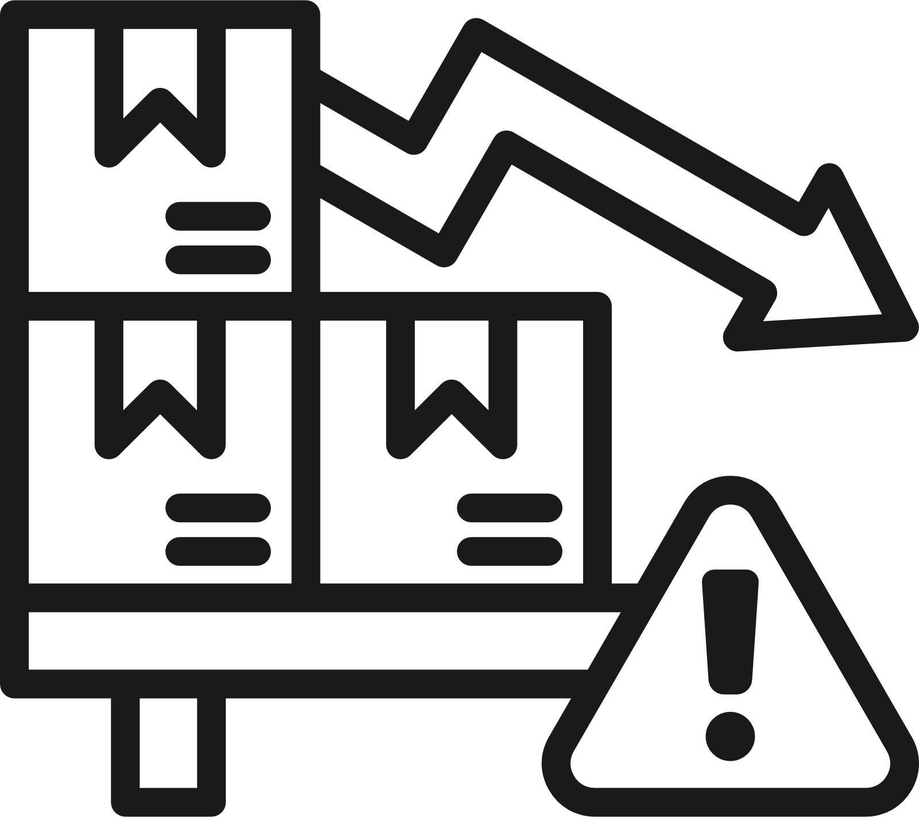
KEY FINDING 2
Low Stock ≠ High Demand
Some products are Low Stock or Out of Stock
However, total quantity sold is often ≤ 5 units
Suggests, restocking should be targeted, not
aggressive
Business implication:
- avoid overreacting to low stock signals
- demand context is essential
Demand must drive restocking decisions, not stock level alone.
Notes:
A sales manager is responsible for overseeing the sales team, developing strategies to drive sales growth, managing customer relationships, and ensuring that the targets set are met. A sales manager also analyses data, forecasts future sales, and provides insights to improve sales performance.

Slide 11

STORE LEVEL FINDING
To allow store managers & operations teams quickly access
REST filter by store allows managers to:
- Focus on their own store
- Act faster
- Avoid information overload
Notes:
A sales manager is responsible for overseeing the sales team, developing strategies to drive sales growth, managing customer relationships, and ensuring that the targets set are met. A sales manager also analyses data, forecasts future sales, and provides insights to improve sales performance.

Slide 12
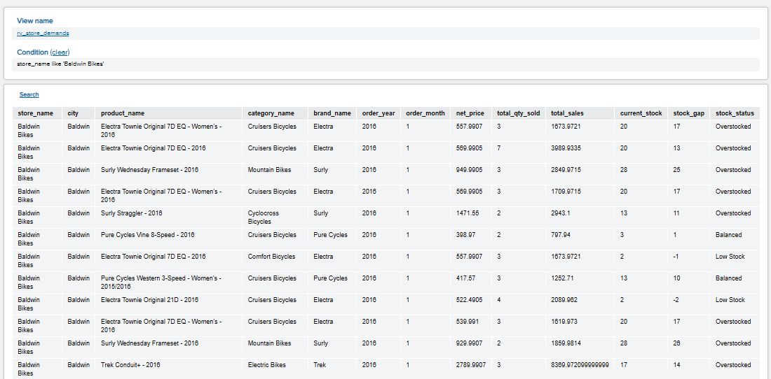

BALDWIN BIKES

Slide 13
Recommendations
4
Notes:
for the first visual, i chose the graph that shows the trend of the profit for every month. the reason why i choice this

Slide 14





OPERATIONAL
Reduce replenishment for consistently overstocked, low-demand products
Redistribute excess stock across stores if demand exists elsewhere
Apply moderate restocking for low-stock items with consistent demand

Slide 15
STRATEGIC
Move towards demand-driven inventory planning
Use stock_status as an early warning indicator
Monitor brand & category performance at store level
Directly address inventory mismatch, slow response times & customer dissatisfaction

Slide 16
BUSINESS VALUE
Solution shifts inventory planning from reactive to proactive
Faster decision-making
Reduced manual analysis’
Better product availability
Lower excess inventory
Improved customer satisfaction & retention
Notes:
Assuming that the current warehouse is located in southeast Australia – which is where most warehouse is located in Australia, the inventory manager can compare that to the number of customers from the different states in Australia. This is important as it can affect the duration of delivery, which may affect the customers liking and satisfaction with the company. Currently, the orders can be delivered to customers in New South Wales, Victoria, Australian Capital Territory and Tasmania relatively quickly. However, the customers in the other parts of the country might not be able to receive their orders in that same duration. This may result in customers not wanting to order from the store again. Hence the inventory has to take this into account and think about setting up another inventory warehouse in Central Australia. This way, there are orders being delivered out from different parts of the country to reach customers faster. The inventory manager can think about splitting up the stocks among both warehouses and if one warehouse ever run low on stocks for specific items, it is possible for them to get some stocks from the other warehouse if the other warehouse has an excess in stocks.

Slide 17






Thank you for
your time!

